Slide 1

From Methods to Impact: Capacity Building for Practical Geospatial SAE
Haoyi Chen
United Nations Statistics Division
Inter-Secretariat Working Group on Household Surveys

Slide 2
The ISWGHS: a primer
Established in 2015 under the aegis of the UNSC
Objectives:
Improve coordination of household surveys
Advance cross-cutting survey methodology
Enhance communication and advocacy
Governance
Membership: 11 international agencies + 10 (rotating) member states
Secretariat: UN Statistics Division
Current co-chairs: WB and UNW
Work through time-bound Task Forces, led by and with contribution from members and non-member experts.

Slide 3

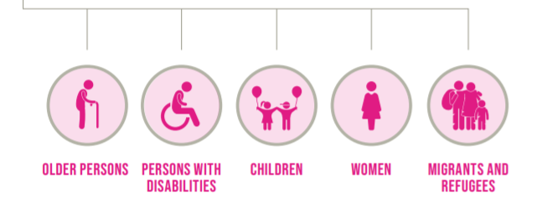
Inter-agency and Expert Group on Sustainable Development Goal Indicators (IAEG-SDGs)
The 2030 Agenda for Sustainable Development
A global blueprint for people, planet, prosperity , peace and partnerships, now and in the future
17 Goals, 169 targets and “Leaving no one behind” principle
The IAEG-SDGs :
Composed of 28 Member States (and representatives of regional commissions, regional and international agencies and CSOs are observers)
Developed the global indicator framework for SDGs (231 indicators)
IAEG-SDGs workstream on data disaggregation:
Compilation of existing guidelines and methodologies on data disaggregation
Preparation of Handbook on data disaggregation for SDGs
Task Force on Small Area Estimation (joint with ISWGHS)

Slide 4

Positioning household survey for the next decade
Organized around 8 technical priorities:​
Enhancing the interoperability and integration of household surveys ​
Designing and implementing more inclusive, respondent-centric surveys ​
Improving sampling efficiency and coverage​
Scaling up the use of objective measurement technologies ​
Building capacity for CAPI, phone, web, and mixed-mode surveys​
Systematizing the collection, storage, and use of paradata and metadata​
Incorporating machine learning and artificial intelligence for data quality control and analysis ​
Improving data access, discoverability, and dissemination. ​
Plus:​
Foster stronger enabling environment:
at national and global level​
https://content.iospress.com/articles/statistical-journal-of-the-iaos/sji220042

Slide 5
The SAE4SDG Toolkit
The Toolkit on Using Small Area Estimation for SDGs (https://unstats.un.org/wiki/display/SAE4SDG/) in Wiki is a space to provide information on methods to produce disaggregated data through small area estimation.
Goal: To provide practical tools with accompanying case studies for countries to use SAE for SDG monitoring.
Objectives:
Using SAE methods to improve SDG data availability for vulnerable population groups
Offering practical guidance and country case studies
Guiding on the enabling environment for using SAE for official data production
Providing a space for partners to document and disseminate their SAE methodologies

Slide 6
What the SAE Toolkit Offer
Many countries have experimented with SAE in the past but few were able to transform from experiment to official production. The Toolkit:
Finds out why this is happening?
Establishes a close link of SAE to SDG monitoring
Provides hands-on exercise, including “semi-synthetic” data (national data + noises) and programming guide.
Incorporates national examples and case studies through two angles: (a) documenting the lessons learnt and challenges of countries in using SAE for official data production; and (b) illustrating SAE practices for indicators under different SDG goals.
Includes main challenges and enabling environment to move from SAE experiment to official production, based on our discussion with national statistical offices.
Provides an up-to-date and comprehensive list of SAE software packages in major languages (R/Stata/SAS/Python).
Notes:
There have been lot of literatures and textbooks on SAE methods, the slide covers the special features of the UNSD SAE Toolkit. What is the value added of the product?
Partners: IAEG-SDGs, ISWGHS, SAE Experts
Establishes a close link of SAE to SDG monitoring: SAE is very resource intensive therefore needs to be focused on a smaller number of indicators. The SDG indicators are therefore a perfect framework to start with if resource is limited.
Provides hands-on exercise, including “semi-synthetic” data (national data + noises) and programing guide. The data sets are used to illustrate, for 3 SDG indicators, on how to work with a complete cycle of SAE estimation such as data preparation, selection of methods, analysis and adaptation and evaluation/benchmarking.
Incorporates national examples and case studies through two angles: (a) documenting the lessons learnt and challenges of countries in using SAE for official data production; and (b) illustrating SAE practices for indicators under different SDG goals.
Includes a long discussion, based on our discussion with countries, on the challenges and enabling environment for countries to move from SAE experiment to official production. We hope this discussion can help countries build appropriate measures, in additional to technical capacity, in using SAE for official production.
Provides an up-to-date and comprehensive list of SAE software packages in major languages (R/Stata/SAS/Python).

Slide 7
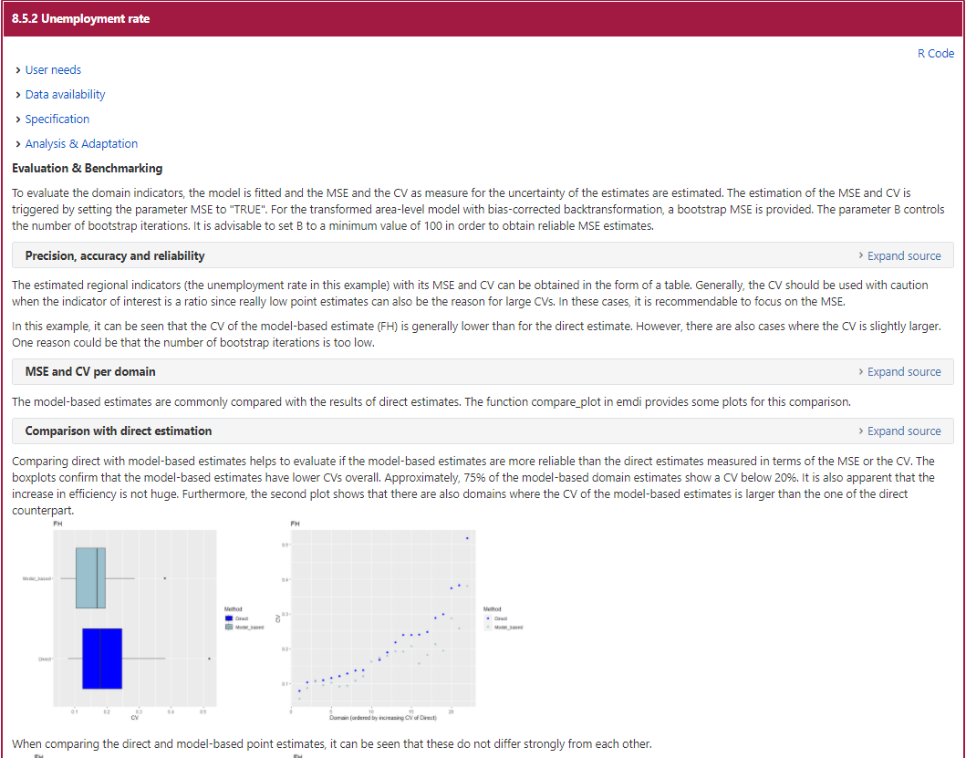
Guiding through steps with practical examples
Notes:
SAE Wiki illustration 1:
Providing hands-on exercise, including data and programing guide.
Three SDG indicators (as outcome variables) are used for illustration purposes, throughout different steps of the SAE production process, such as data preparation, selection of methods, analysis and adaptation and evaluation/benchmarking.

Slide 8
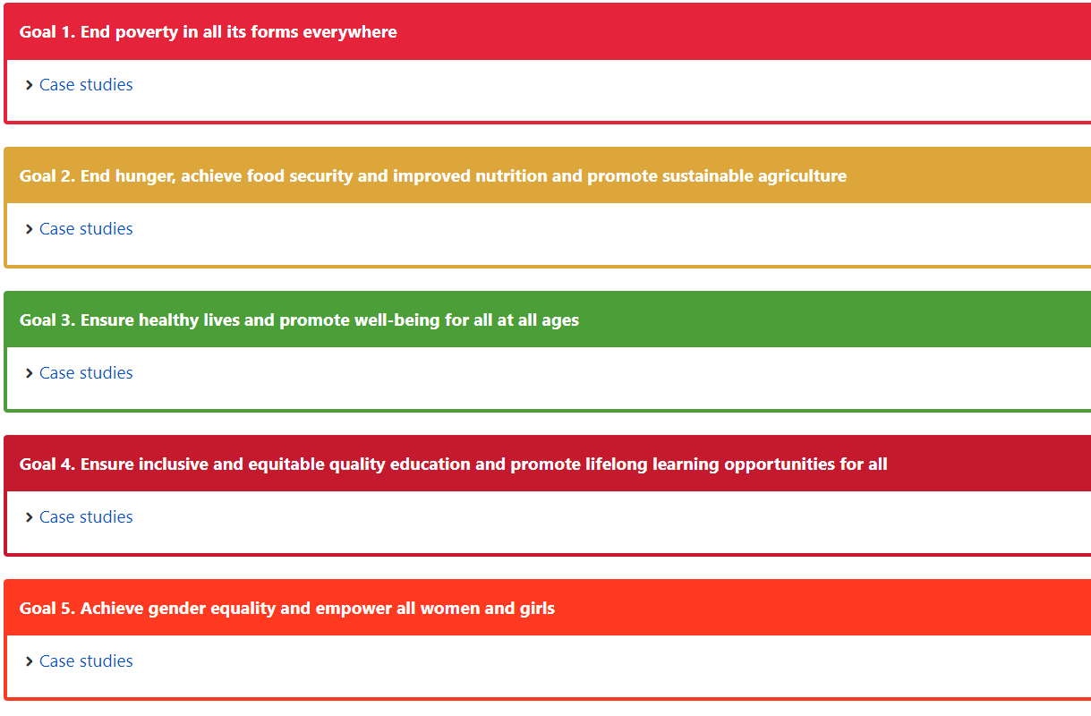
Case studies covering different SDG goals/indicators
Notes:
SAE Wiki illustration 2:
Case studies for indicators under relevant SDG goals
Note: not all goals are populated yet, we are still incorporating new case studies; SAE has typically been used for poverty estimates

Slide 9
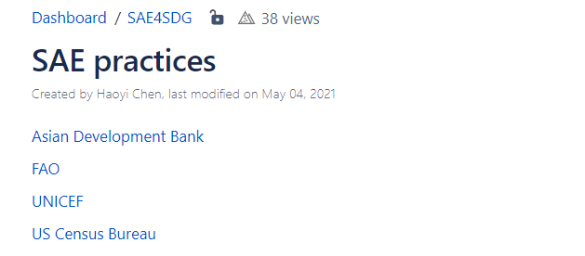
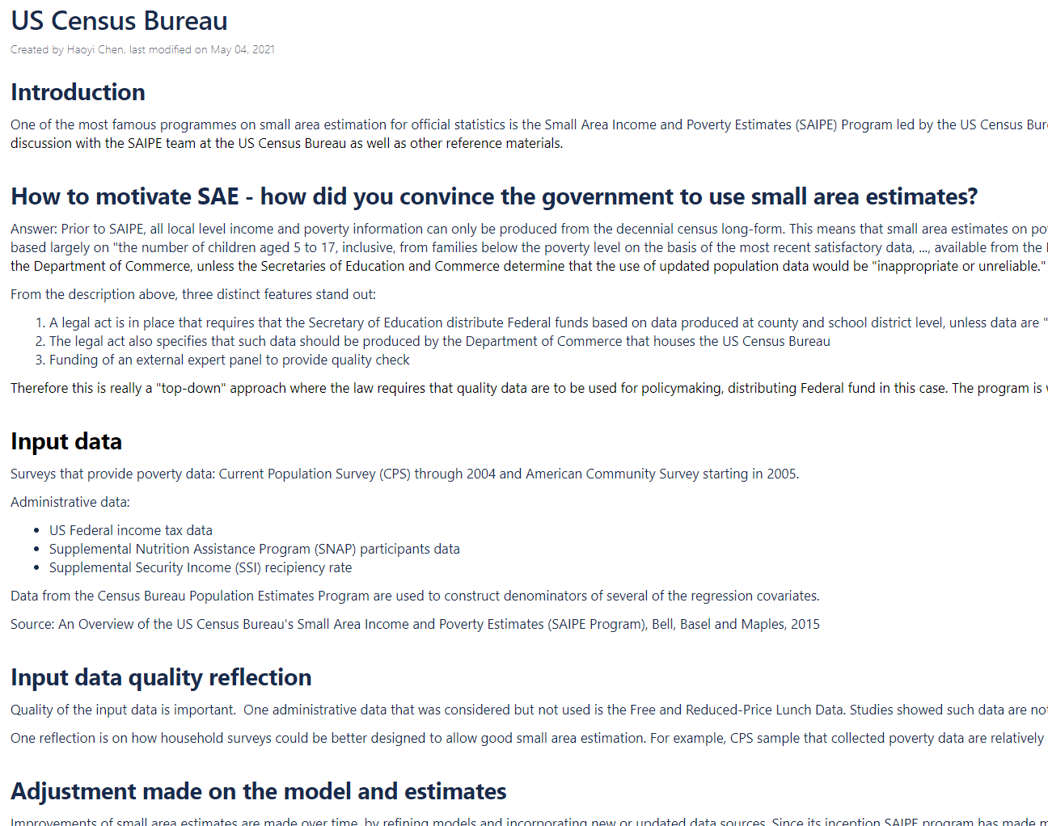
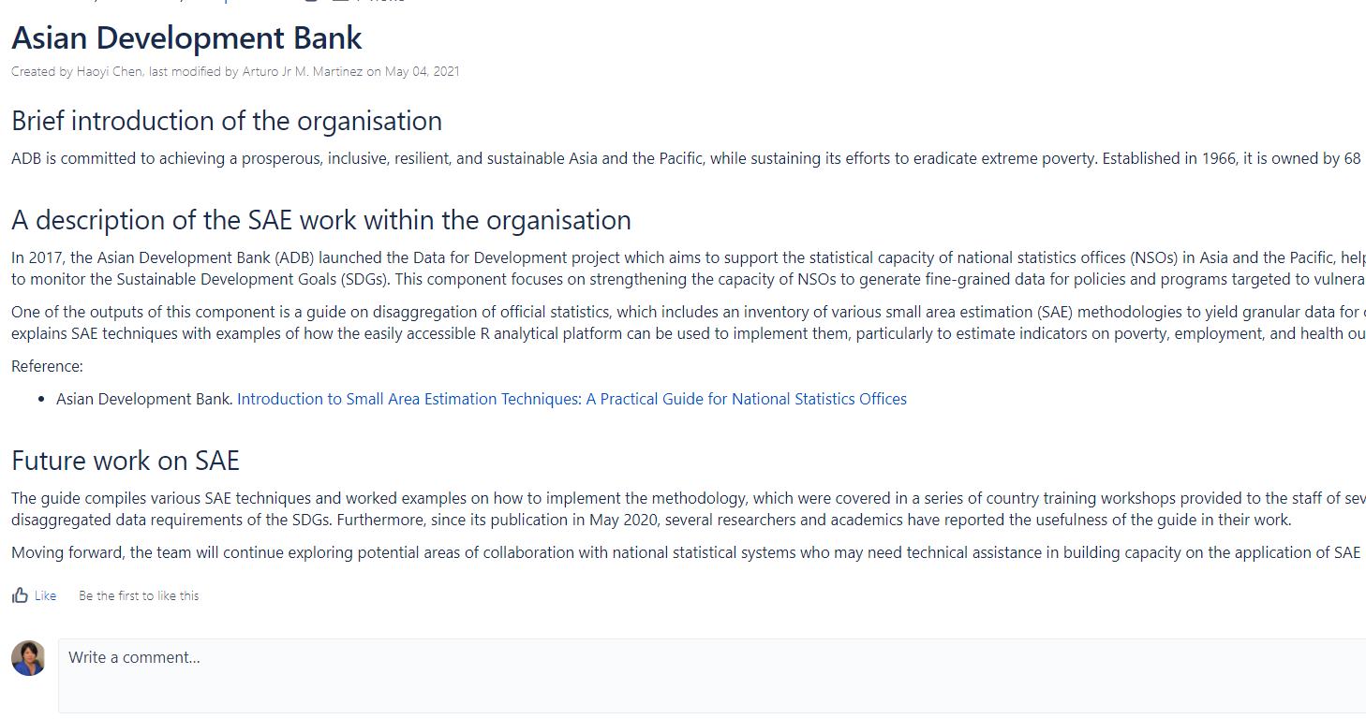
SAE methodologies used by countries and international agencies
Notes:
SAE Wiki illustratin 3:
The Wiki documents the work of countries and international agencies on their SAE work.
For countries, a lot focus has been on the practical side rather than specific models used. This helped us putting together challenges countries face and how they manage the challenges

Slide 10
Challenges in using SAE for official statistics
Lack of interest and support from the top management
Lack of dedicated resources for SAE research and implementation
Lack of in-house technical capacity
Lack of proper input data (access to/poor quality of admin data source)
Reluctance about the use of model-based estimates (vs. survey estimates that are design-based/model-assisted)
Difficulties in communicating the technical aspects to users
Notes:
The next 2 slides are the main focus of our work on SAE. SAE method has been around for a long time but has not really been adopted by national statistical offices.
The WB has a team working with countries to develop “poverty mapping” using SAE method but still very few countries were able to use the method independently
We carried out focus group discussion with countries
that have successfully adopted SAE for regular data production and ask about their experiences
that did not manage to use SAE method for regular data production and ask for challenges
The discussion with countries was documented and summarized into two sections:
Challenges: Challenges in using SAE for official statistics - SAE4SDG - UN Statistics Wiki
Enabling environment: Enabling environment to foster the use of SAE for official data production - SAE4SDG - UN Statistics Wiki
Delete..

Slide 11
Challenges in using SAE for official statistics (cont.)
"We did an experiment using small area estimation method for poverty but the results were not consistent with our own estimates so we did not pursue it again."
"We do not have good input data source for SAE - census data are outdated, and administrative data sources do not have good coverage and lack proper auxiliary variables."
"SAE method is complicated and we are not comfortable with independently developing the method."
"It is very difficult to convince the managers to use model-based estimates."
"Producing SAE requires a lengthy period of looking for input data, finding the right auxiliary variables, testing different models and their assumptions and validating the estimates."
Source: UNSD conversations with NSOs
Notes:
These are quotes from countries. Key messages on the challenges:
- SAE is resource-intensive.

Slide 12
Enabling environment for SAE
Establishing a clear and focused objective that links SAE to data use for policymaking
Building the legal foundation for using SAE for official data production
Fostering an environment for research and development
Design-based versus model-based estimates: a changing culture in the national statistical offices
Input data for SAE
Maintaining a high and fit-for-purpose quality standard
Collaboration
Capacity building
Transparency in releasing methodology and communicating quality
Notes:
Thank you Yongyi. My name is Haoyi Chen, I am the Coordinator of the Inter-Secretariat Working Group on Household Surveys. In the next few slides, I will be talking about the enabling environment for successfully implementing SAE programmes. These information was gathered by talking to countries that have been successful in implementing SAE in their offices; and is available on the UN Toolkit on Using Small Area Estimation (SAE) for SDGs. In this presentation I will be focusing 4 areas.

Slide 13
Lessons learnt: driven by needs for key policies and funding decisions
Colombian National Development Plan 2018-22 made it mandatory to redesign the national monetary transfer programs (Jóvenes en Acción and Familias en Acción), for population in poverty and in extreme poverty. This needs poverty data at municipal level. (Colombia)
In 2009, the law of the Fondo Común Municipal (FCM) required the Ministry to provide poverty rate estimates every 2 years for all comunas in the country. Funding to all comunas will be allocated based on such data. (Chile)
The 2005-2009 BPS Strategic Plan for Statistical Development defined “the development of an efficient and low-cost methodology, which allows for the creation of small area and local specific statistics data” as one of the main activities to support government decentralization (Indonesia)
The Cabinet of the Government of Jamaica made a request for the Statistical Institute of Jamaica to use small-area estimation for poverty mapping, to produce poverty data for smaller geographical areas within the country. (Jamaica)
Improving America’s Schools Act: “the number of children aged 5 to 17, inclusive, from families below the poverty level on the basis of the most recent satisfactory data, ..., available from the Department of Commerce” (US)
Notes:
First of all, all successful SAE programmes within NSOs are driven by key policy needs, esp. in allocating funding at community level and sometimes with strong legal backings. For example,
- xxx
This law further requires that in Fiscal Year 1997, the Secretary of Education use updated data on poor children for counties and, beginning in Fiscal Year 1999, updated data for school districts, published by the Department of Commerce, unless the Secretaries of Education and Commerce determine that the use of updated population data would be "inappropriate or unreliable."

Slide 14
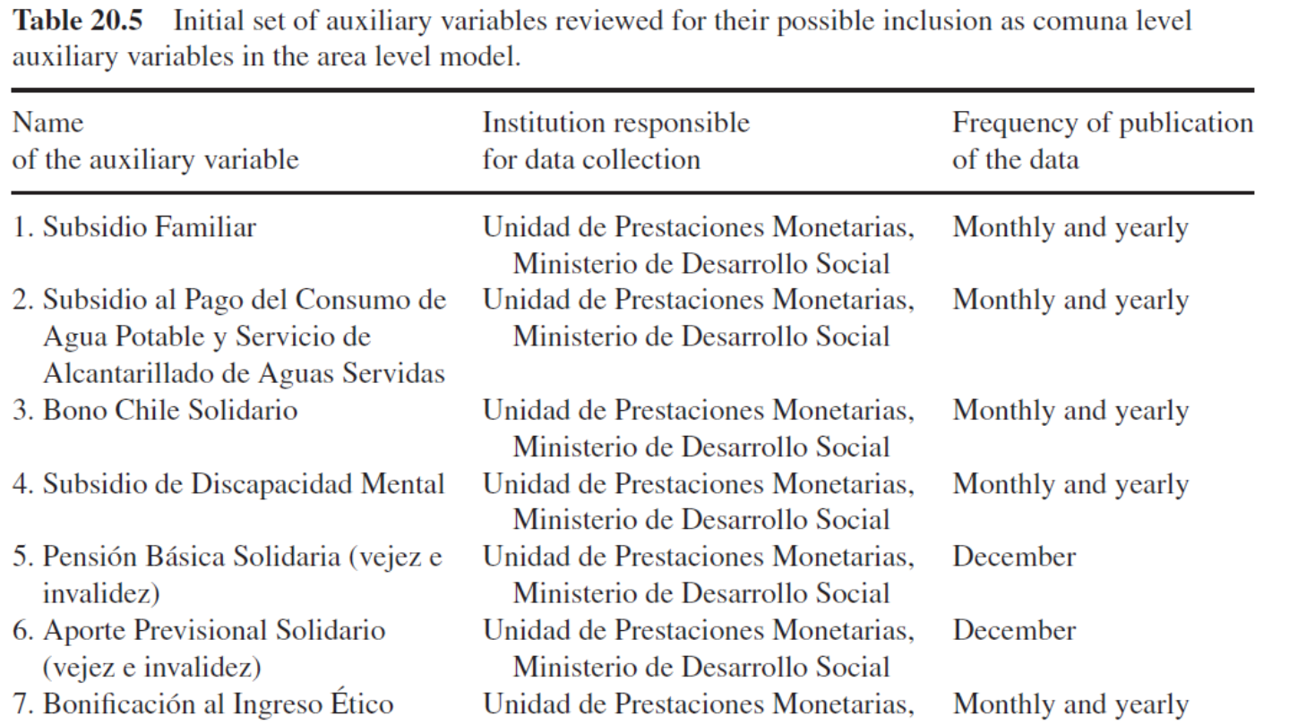
Lessons learnt: access to good quality input data
Access to auxiliary data sources (e.g., administrative data), regularly
Input data are of good quality:
Coverage, accuracy and timeliness
Availability of auxiliary variables that have good prediction power for the outcome indicator
Source: Example from Chile, Casas-Cordero, Encina and Lahiri (2016)
Notes:
SAE is the integration of household survey data (collects more data items but cannot cover small geographic areas) and another data source (auxiliary data) that have better population coverage but with fewer variables (e.g., census, administrative data, or non-traditional data)
A very important aspect for successfully implement SAE program is good auxiliary data sources, in terms of
coverage, accuracy and timeliness of the auxiliary data source
How often are the auxiliary data source updated?
Availability of auxiliary variables that have good prediction power for the outcome indicator
To use administrative data as an auxiliary data source, data access is usually a challenge. This is why many low income and lower-middle income countries can only use censuses as the auxiliary data source.
The table shown on the slide is what Chile uses to assess its auxiliary data source (auxiliary variable, how frequent data are available and who owns the data)

Slide 15
Capacity building on SAE
eLearning course: a joint effort of ECLAC-UNSD-UNFPA: https://learning.officialstatistics.org/user/index.php?id=103
Reading materials
Recorded videos (50 videos with about 10-15 minutes for each video), organized in 10 modules
Evaluation materials including weekly computer-graded assessments, two mid-term projects, and a final project
R program language code that can be used for SAE modelling
Offering self-paced and guided lessons: English, French and Spanish
Supporting countries to the SAE conference
Regional training workshops and “experts clinic”
Notes:
More information is available on the wiki. For the next steps:
We will continue to add case studies
Provide trainings through the eLearning course
Organise small technical group discussion (countries + academic) to address specific questions from countries
Explore potential of using non-traditional data sources such as remote sensing and mobile phone data for SAE

Slide 16
Offering more and better training
Reflecting on the learning experiences: R skills, linear model, busy schedules, sometimes the interested students do not really work on the area, course material very intense
Notes:
Please acknowledge SIAP, Deputy director Seiji Takata <seiji.takata@un.org>

Slide 17
Geospatial data for SAE: a review of its potential, limitations and effectiveness
An overview of SAE method, why and the audience of the review
Input data: geospatial data and training data
Geospatial SAE methods
Skills and tools to apply the methods
Future research and work
A draft available: here; a revision is available in one week
Partners: World Bank, SAE experts, IAEG-SDGs, GGIM-ISGI
Notes:
More information is available on the wiki. For the next steps:
We will continue to add case studies
Provide trainings through the eLearning course
Organise small technical group discussion (countries + academic) to address specific questions from countries
Explore potential of using non-traditional data sources such as remote sensing and mobile phone data for SAE

Slide 18
Geospatial data for SAE: hands-on guidance
Developing a step-by-step guidance on:
Accessing geospatial data for SAE
Selecting the types of data to use
Illustrating with datasets
Partners with ECA, ESCAP and the World Bank
Notes:
More information is available on the wiki. For the next steps:
We will continue to add case studies
Provide trainings through the eLearning course
Organise small technical group discussion (countries + academic) to address specific questions from countries
Explore potential of using non-traditional data sources such as remote sensing and mobile phone data for SAE

Slide 19
Are you interested in: - Learning SAE and geospatial SAE - Receiving technical support for your office - Providing your expertise and supporting countries - Receiving Newsletter of the ISWGHS - Working as an intern for the UN chen9@un.org
Notes:
More information is available on the wiki. For the next steps:
We will continue to add case studies
Provide trainings through the eLearning course
Organise small technical group discussion (countries + academic) to address specific questions from countries
Explore potential of using non-traditional data sources such as remote sensing and mobile phone data for SAE

